Slide 1


Information Visualization
ARL Digital Scholarship Institute
August 1, 2018
Stefan Elnabli
Media Curation Librarian
UC San Diego Library
stelnabli@ucsd.edu
Megan Ozeran
Data Analytics and Visualization Librarian
mozeran@illinois.edu

Slide 2
Agenda at a Glance
What is Information Visualization
How to Evaluate Visualizations
Visualization Components
Chart Families & Types
Visualization Tools and RAW

Slide 3
Learning Goals
Identify one or two opportunities to incorporate information visualization methods into faculty or student collaborations toward promoting information visualization as a mode of digital scholarship research and dissemination.
Critically evaluate information visualizations in order to understand their content as well as determine the authority of the message.
Create new information visualizations using standard principles and the RAWgraphs tool, in order to enhance your and your colleagues’ scholarship.

Slide 4
What is Information Visualization?
The graphic representation of information

Slide 5
“A good visualization is:
reliable information;
visually encoded so relevant patterns become noticeable;
organized in a way that enables at least some exploration, when it’s appropriate;
and presented in an attractive manner,
but always remembering that honesty, clarity, and depth come first.”
- Alberto Cairo
Source: Cairo, A. The Truthful Art: Data, Charts, and Maps for Communication. Pearson: 2016. p. 12

Slide 6
Why visualize?
Enhance understanding of a topic or area of research
Use as evidence to support an argument
Clarify a result
Illustrate results
Make graphical inferences
Create new ways of seeing

Slide 7
Anscombe’s Quartet
Source: https://en.wikipedia.org/wiki/Anscombe%27s_quartet

Slide 8
Anscombe’s Quartet
Source: https://en.wikipedia.org/wiki/Anscombe%27s_quartet

Slide 9
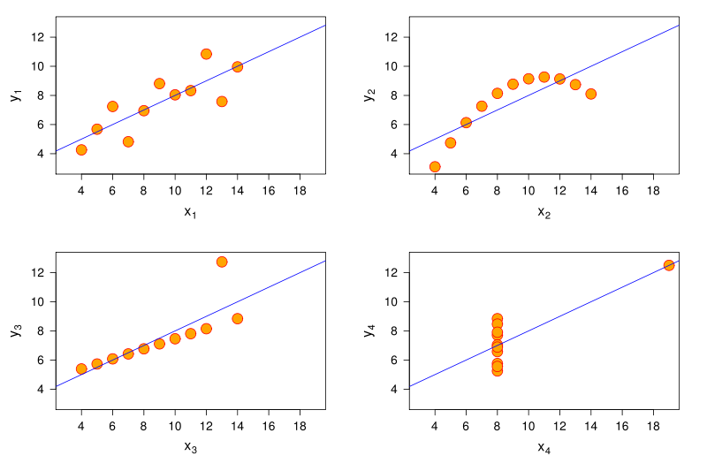
Anscombe’s Quartet
Image by Schutz: Anscombe.svg, CC-BY-SA 3.0, https://commons.wikimedia.org/wiki/File:Anscombe.svg

Slide 10
Information Visualization in Digital Scholarship

Slide 11
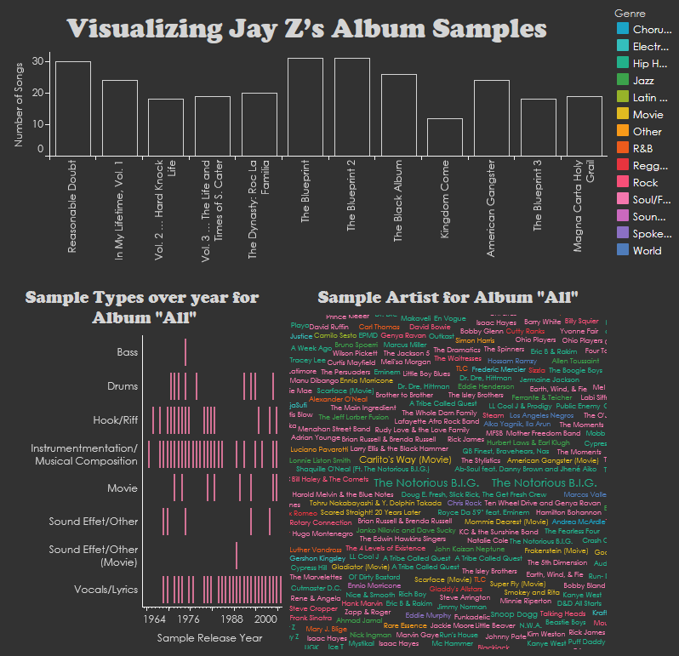
#TheJayZMixtape
by Kenton Rambsy
University of Texas at Arlington
https://doi.org/10.21900/pww.2

Slide 12
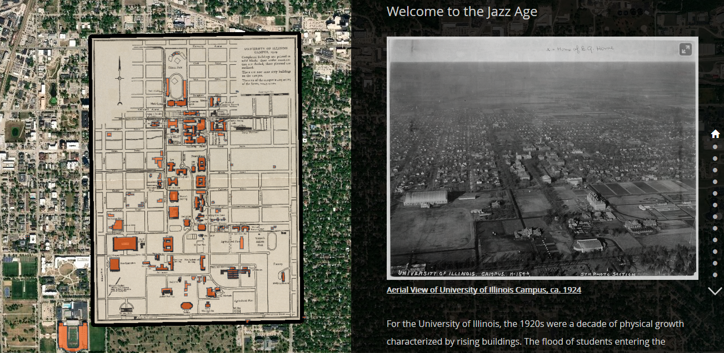
The Jazz Age Building Tour: 1920-1930, by Mindi Zhang, edited by Joe Porto and James Whitacre
University of Illinois, https://arcg.is/CzXe1

Slide 13
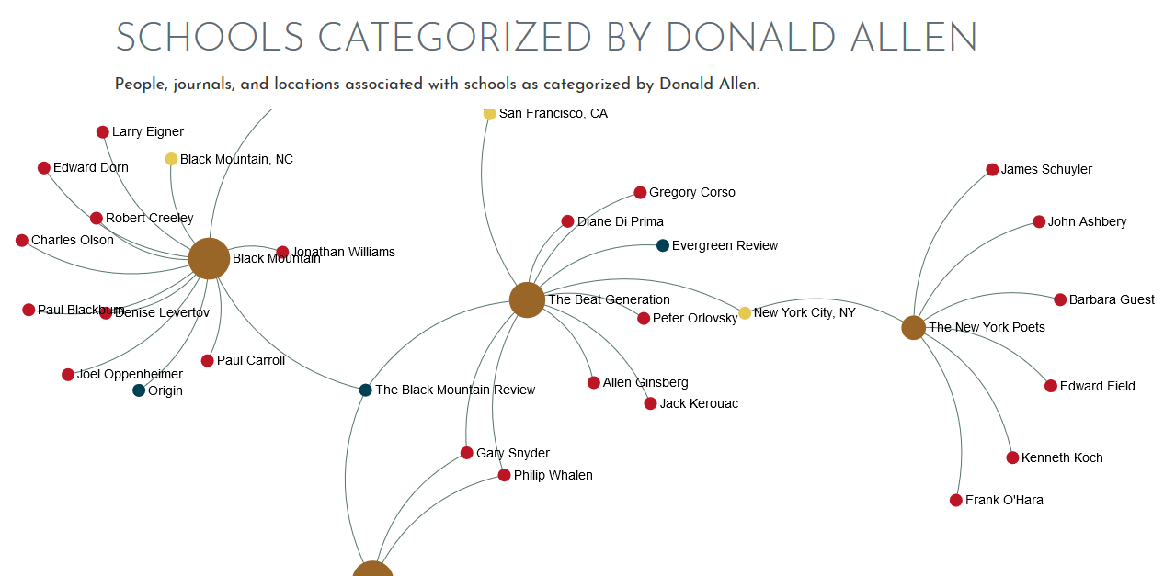
Networking the New American Poetry, by Lisa Marie Chinn, Brian Croxall, and Rebecca Sutton Koeser
Emory University, https://danowski.digitalscholarship.emory.edu/nnap/network/

Slide 14
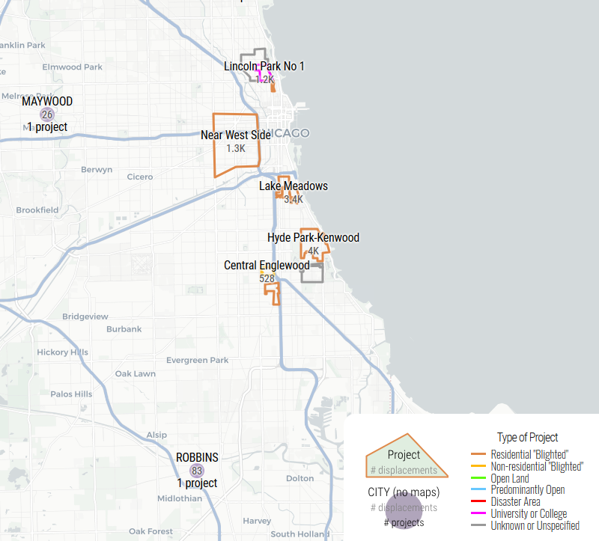
Renewing Inequality:
Urban Renewal,
Family Displacements,
and Race 1955-1966
Digital Scholarship Lab,
University of Richmond
dsl.richmond.edu/panorama/renewal/

Slide 15
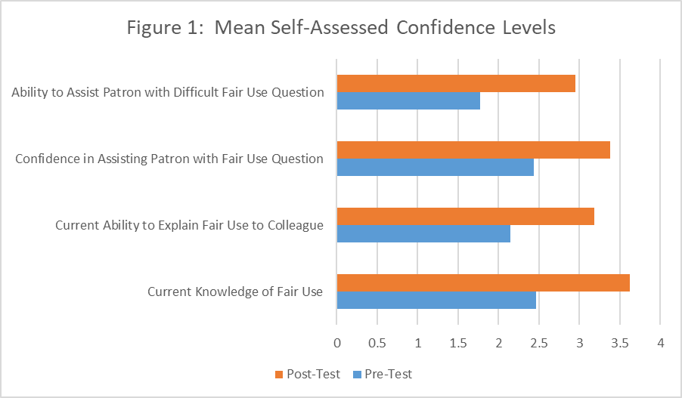
Example from an awesome colleague

Slide 16
Brainstorming exercise
Break up into groups of 3 or 4
Spend about 5-10 minutes thinking about some research questions in your domain that might benefit from or be answered by data visualization.
Spend another 10 minutes discussing your ideas with the group, focusing on challenges and opportunities.

Slide 17
Activity break!

Slide 18
Evaluating Visualizations

Slide 19
The Trifecta Checkup
The visualization’s question (or purpose or argument)
The underlying data
The visual form
Source: Fung, K. “Junk charts trifecta checkup: The definitive guide.” Junk Charts. Retrieved from http://junkcharts.typepad.com/junk_charts/junk-charts-trifecta-checkup-the-definitive-guide.html

Slide 20
Evaluate this chart’s…
Question
Data
Visual

Slide 21
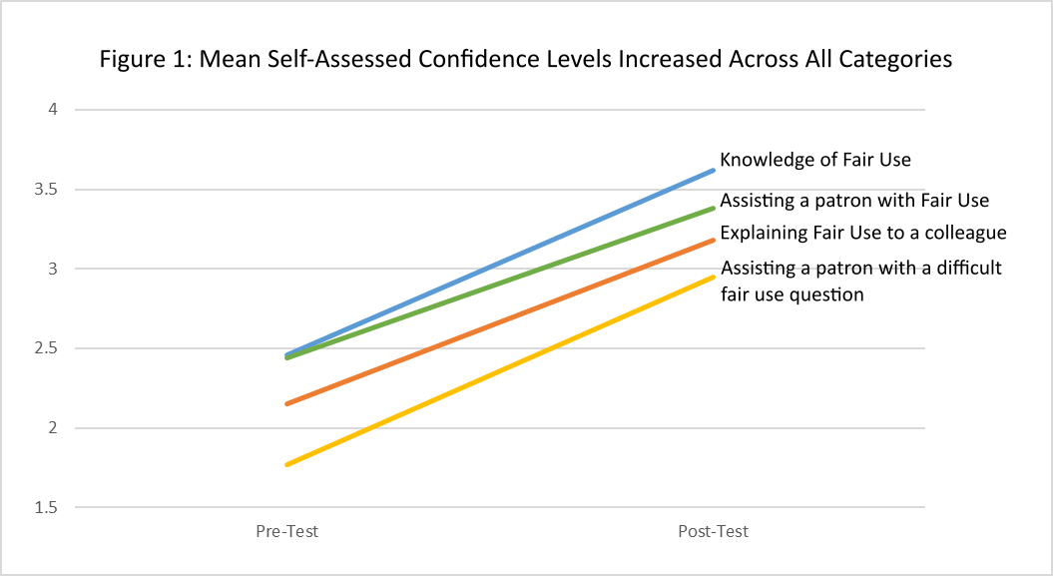
Evaluate this chart’s…
Question
Data
Visual

Slide 22
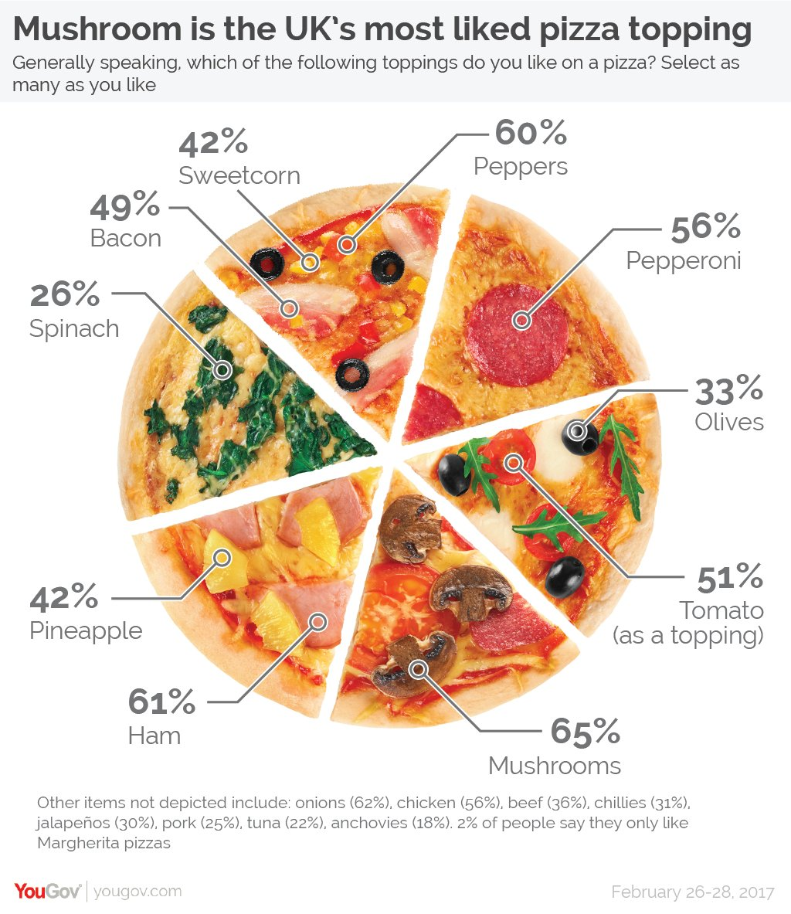
Evaluate this chart’s…
Question
Data
Visual
Example from JunkCharts, http://junkcharts.typepad.com/junk_charts/2017/03/light-entertainment-were-very-sorry-but-this-is-not-a-pie-chart.html

Slide 23
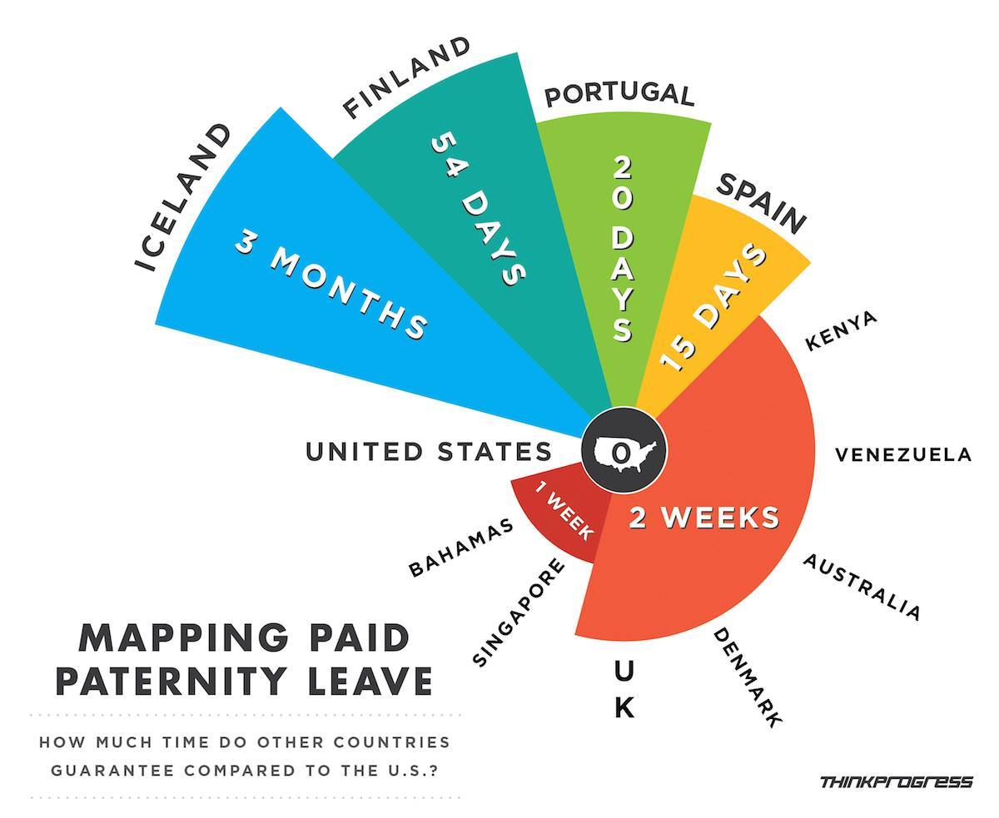
Evaluate this chart’s…
Question
Data
Visual
Example from Bryce Covert and Adam Peck for ThinkProgress, “U.S. Paid Family Leave Versus The Rest Of The World, In 2 Disturbing Charts,”
https://thinkprogress.org/u-s-paid-family-leave-versus-the-rest-of-the-world-in-2-disturbing-charts-365324eeba45/

Slide 24
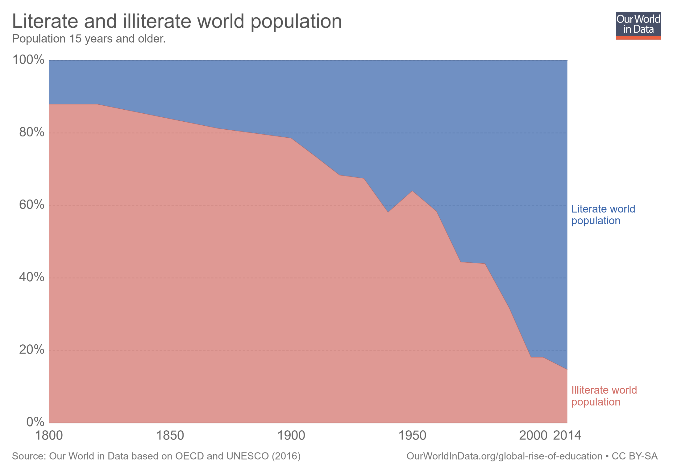
Evaluate this chart’s…
Question
Data
Visual
Example from Max Roser, “The short history of global living conditions and why it matters that we know it,”
Our World in Data, https://ourworldindata.org/a-history-of-global-living-conditions-in-5-charts

Slide 25
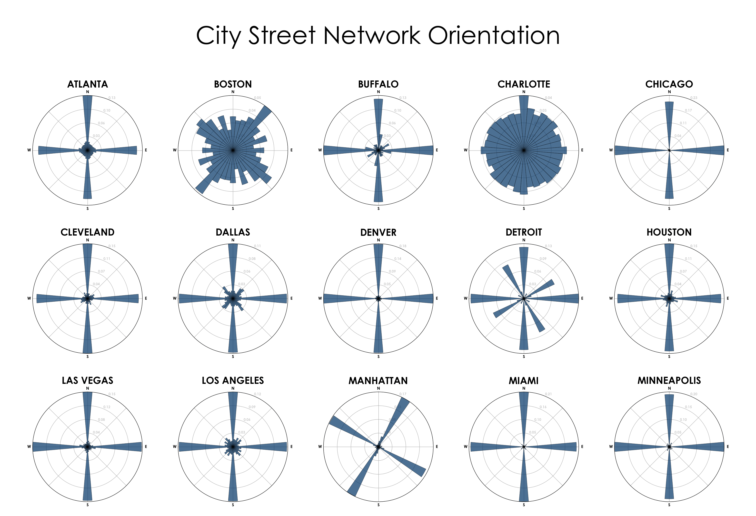
Evaluate this chart’s…
Question
Data
Visual
Example from Geoff Boeing, “Comparing US City Street Orientations”
https://geoffboeing.com/2018/07/comparing-city-street-orientations/

